Slide 1
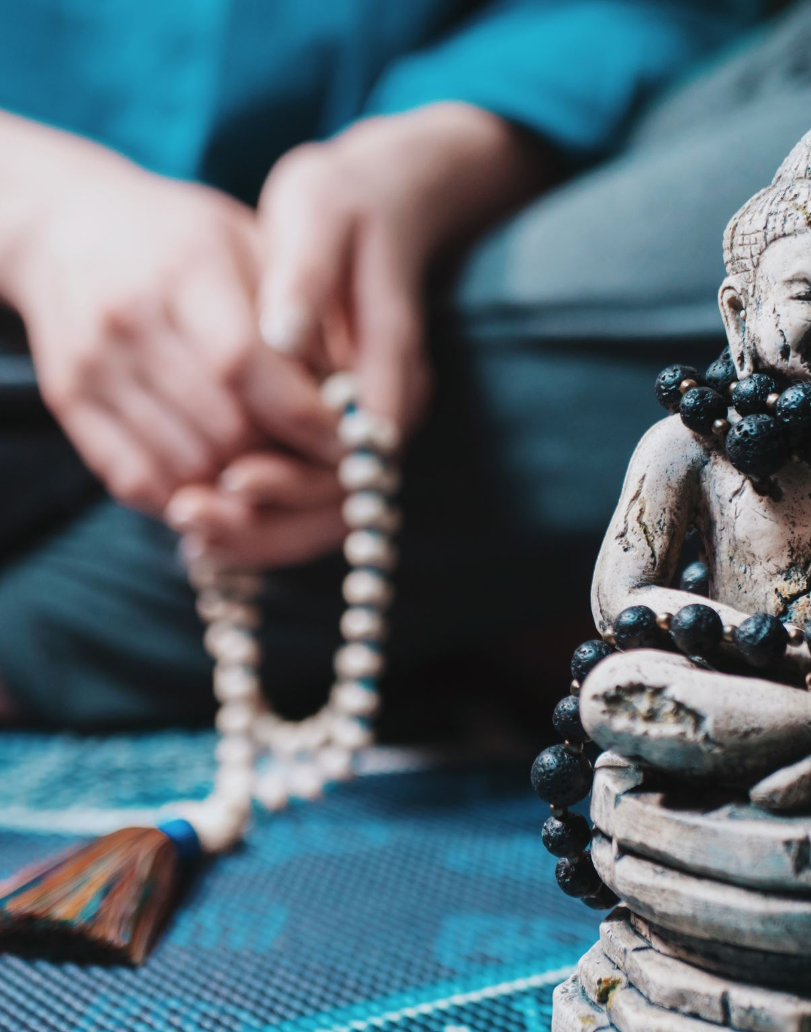
Catenian International Rosary
The Joyful Mysteries
Hosted by Australia
28th January 2023

Slide 2
Introduction: Brother Graham Short, Vice-President Australian National Council

Slide 3
The Apostles Creed Led by Brother Peter Woodford, United Kingdom
The Apostles’ Creed
I believe in God the Father almighty, Creator of heaven and earth. And in Jesus Christ, His only Son, our Lord, Who was conceived by the Holy Spirit, born of the Virgin Mary, suffered under Pontius Pilate, was crucified, died, and was buried. He descended into hell; on the third day He rose again from the dead; He ascended into heaven, and sits at the right hand of God the Father almighty, from thence He shall come to judge the living and the dead. I believe in the Holy Spirit, the holy Catholic Church, the communion of saints, the forgiveness of sins, the resurrection of the body and life everlasting. Amen
Our Father, Hail Mary, Glory Be

Slide 4
First Joyful Mystery – The Annunciation Lk. 1:26-38 Led by Brother Graham Short, Australia
From Scripture: “Hail, full of grace, the Lord is with you! ….. you have found favour with God. And behold, you will conceive in your womb and bear a son, and you shall call his name Jesus.”
Intention – Growth in joy and thanksgiving for the Lord’s graces and blessings in our lives
Reflection: When we pray - Hail Mary, full of Grace, let us remember that Mary is full of Grace because the fullness of the Lord is with her – it is pure grace that leads the Angel to announce the Good News of the birth of Jesus to Mary. Yet, without Mary’s consent and acceptance of her role in salvation history, Jesus might not have come into the world. Let us remember the humility and response of Mary to the angel each time we pray the Hail Mary.
Prayer: Mary, full of grace, we pray that you will walk with us in our joys and our sorrows. Intercede for us for the strength and the faith to follow your Son, so that our lives, our families, and our work may become a vocation to care with faith, hope and love for those around us.
Our Father, 10 Hail Marys, Glory Be, Fatima Prayer

Slide 5
Second Joyful Mystery – the Visitation Lk. 1:39-45 Led by Brother Peter Moriarty from Australia
Scripture: “…. Elizabeth was filled with the Holy Spirit and she exclaimed with a loud cry, “Blessed are you among women, and blessed is the fruit of your womb! And why is this granted me, that the mother of my Lord should come to me? For behold, when the voice of your greeting came to my ears, the babe in my womb leaped for joy.”
Intention – That we be a source of blessings for those we visit and care for.
Reflection: The response of Elizabeth to Mary’s visit was one of thanksgiving and joy in the Holy Spirit. In greeting Mary with the words, ‘blessed are you among women and blessed is the fruit of your womb!,’ Elizabeth reminds us to also be grateful for Mary’s obedience. Through her obedience, she would allow the handmaid of the Lord to carry the child Jesus, so that we, and all subsequent generations may have life to the full.
Prayer: Lord, fill us with your joy, let us be thankful for your love and your mercy, as our Lady, your mother and our mother teaches us the art of listening to your voice, and do whatever you ask of us, in obedience to the Father’s will for us. Mary, Mother of God, teach us to ponder all these things in our hearts, that we may learn how to listen to your Son every day.
Our Father, 10 Hail Marys, Glory Be, Fatima Prayer

Slide 6
Third Joyful Mystery – the Nativity of our Lord – Lk. 2:1-14 Led by Bro Gift Gobah from Zimbabwe
From Scripture: “I bring you good news of a great joy which will come to all the people; for to you is born this day in the city of David a Saviour, who is Christ the Lord. And this will be a sign for you: you will find a babe wrapped in swaddling cloths and lying in a manger.”
Intention – That the Christ child may be born in our families, bringing his simplicity, humility and love into our lives
Reflection: It is important to remember that Jesus was not born in a King’s palace, but in a manger, with the animals and the shepherds. The joy at his birth was not shared by all. Yet, the sign for us is that we find a vulnerable baby wrapped in swaddling cloths lying in a manger. Swaddling cloths were bands of cloth used to wrap the newborn. There is a tradition that the shepherds used to provide the ‘lambs without blemish’ for the temple sacrifice at Passover. The first new-born lamb would be wrapped in swaddling cloths for this purpose – so it may be that Jesus, the lamb of God without blemish was wrapped in swaddling cloths in preparation for his future Passover sacrifice as the Lamb of God who takes away the sins of the world.
Prayer: Lord, you were born in a manger, among the animals and the shepherds who paid you homage. Fill us with your humility, and lead us in being role models of charity and humility for our families, friends, colleagues, and those we care for in your name. And when we carry the cross of love in our lives, fill us with the Spirit who strengthens us in our moment of need.
Our Father, 10 Hail Marys, Glory Be, Fatima Prayer

Slide 7
Fourth Joyful Mystery – The presentation of Our Lord in the Temple Lk. 2:22-38 Led by Bro Richard Galea from Malta
Scripture :
“Behold, this child is set for the fall and rising of many in Israel, and for a sign that is spoken against(and a sword will pierce through your own soul also), that thoughts out of many hearts may be revealed.”
Intention – That we remain faithful to Jesus in times when our faith is tested
Reflection: The Joy at the birth of Jesus is always vulnerable to danger and betrayal – Indeed, the birth of Jesus would find its purpose in his life, death and resurrection at Easter. Christmas and Easter are part of a unity – of how God walks with us in our salvation history. This child, who although the same as God, did not see being the equal of God as a reason to dominate us or to rule it over us. Instead, in humility, and in obedience to the Father’s will, he emptied himself in love for us – so that we may have life, life to the full. In following Jesus, how do we walk in the path of humility, in love for our family and friends, and those the Lord sends into our lives for us to be a good neighbour to?
Prayer: Lord, for the times when we feel misunderstood, hurt, and betrayed, give us the strength and the grace to carry our cross every day. In this way, may you walk with us along the way of faith, hope and love for the sake of our families, friends, neighbours and those we find difficult to get along with.
Our Father, 10 Hail Marys, Glory Be, Fatima Prayer

Slide 8
Fifth Joyful Mystery – The finding of Jesus in the Temple Lk. 2:41-52 Led by Bro. John Tweedie from Australia
Scripture: “How is it that you sought me? Did you not know that I must be in my Father’s house?”
Intention – That we always remember that the Father’s house is a house of prayer
Reflection: Imagine the anxiety of Mary and Joseph when they realised that Jesus was not with them. How worried would they have been, imagining the worst? Yet, their joy at finding Jesus in the Temple must have amazed them – indeed, his interactions with all those who heard him were amazed at his understanding and answers as a 12 year old. Yes, Jesus must be in his Father’s house – where there are many mansions, and one day, we too will join him and the Saints in Our Father’s house also.
Prayer: Lord, when the disciples asked you to teach them to pray, you taught them to pray to our father in heaven. As we meditate on the finding in the Temple, teach us to be in our Father’s house, where there are many mansions. Teach us to avoid distractions in our Father’s house, so that we may learn to be still and know that you are God.
Our Father, 10 Hail Marys, Glory Be, Fatima Prayer

Slide 9
Cardinal George Pell, RIP Prayer for Cardinal George Pell, former Archbishop of Sydney and Melbourne Bro. Deacon Ian Wells from Reigate Circle to lead us from now on, and to give us a Deacon’s blessing
We pray for Cardinal George Pell. We thank God for Cardinal Pell’s leadership of the Australian Church, and may his soul rest in peace as he joins the saints in the heavenly banquet. Amen

Slide 10
Pope Emeritus Benedict XVI, RIP
We pray for Pope Emeritus Benedict XVI. May his soul rest in peace as he rejoices with the saints in heaven for the gift of life, now transformed into eternal life. Amen

Slide 11
Nunc Dimittis
Brothers – Let us recite our Catenian Prayer for Pope Emeritus Benedict, Cardinal Pell and all deceased brothers and members of their families:
Out of the depths I cry to thee, Lord, Lord, hear my voice! Let thine ears be attentive to the voice of my supplication!
If thou, Lord, shall observe iniquities, Lord, who shall endure it? For with there is merciful forgiveness, and by reason of thy law I have waited for thee Lord.
My soul has relied on his word; my soul has hoped in the Lord.
From the morning watch until night let Israel hope in the Lord. Because with the Lord there is mercy , and with him plentiful redemption.
And he will redeem Israel from all its iniquities.
Eternal rest give to them, Lord, And let perpetual light shine on them. May they rest in peace. Amen.”

Slide 12
Final Blessing – Deacon Ian Wells from Reigate Circle, Province 19
The Lord be with you
And also with you
May Almighty God bless you + In the Name of the Father and of the Son and of the Holy Spirit
Amen
Go in peace, glorifying the Lord by your life

Slide 13
St. Mary of the Cross MacKillop
Saint Mary of the Cross MacKillop (15 January 1842 - 8 August 1909), was an Australian Roman Catholic nun who founded the Sisters of St Joseph of the Sacred Heart and a number of schools and welfare institutions throughout Australasia with an emphasis on education for the poor. Since her death she has attracted much veneration in Australia and internationally. She was beatified on 19 January 1995 by Pope John Paul II.
Pope Benedict XVI prayed at her tomb during his visit to Sydney for World Youth Day 2008. In December 2009, Pope Benedict XVI approved the Roman Catholic Church's recognition of a second miracle attributed to her intercession. Pope Benedict canonised Saint Mary MacKillop on 17 October 2010. St. Mary MacKillop is the patron saint of Australia, Her feast day is celebrated on August 8.

Slide 14
Our Lady of the Aborigines - Aboriginal Madonna - Karel Kupka 1918-1993
The painting is displayed in St Mary’s Star of The Sea Cathedral in Northern Territory, Australia
Jesuit missionaries first arrived in the Northern Territory in 1882 to minister to the Aborigine population. A church was built, Our Lady Star of the Sea, in 1889 but destroyed by a cyclone in 1897. It was rebuilt and enlarged over the years until, during World War II, Japanese bombs destroyed it and many other buildings in the city. The day of the first raid, February 19, 1942, is still remembered as “Bombing of Darwin Day”.
The current building was built in 1962 and has a distinctively modern style. Cathedral displays the painting known as the Aborigine Madonna; a painting of the Blessed Virgin Mary, with the baby Jesus, depicted as Aborigines. Although many traditional paintings such as this show the Blessed Virgin holding Jesus in her lap, this one shows him being carried on her shoulder, in the same way as the aborigines from the Northern Territory carry their children.

